Slide 1
We will get started shortly.
International Science Nutrition Society – CURARE CAUSAM - ISNS 2023

Slide 2
ISNS CASE STUDY
With Dr. Norbert Ketskes on Parkinson’s Disease
International Science Nutrition Society – CURARE CAUSAM - ISNS 2023

Slide 3
Medical Disclaimer
The information provided is for educational purposes and is not intended as medical advice, or a substitute for the medical advice of a physician or other qualified health care professional. This is for science and educational purposes only and cannot be used in any aspect for sales or marketing. You should not use this information for diagnosing a health or fitness problem or disease. You should always consult with a doctor or other health care professional for medical advice or information about diagnosis and treatment. This is Confidential. Do not distribute—for scientific educational purposes only.
International Science Nutrition Society – CURARE CAUSAM - ISNS 2023

Slide 5
DR. NORBERT KETSKÉS, MD
Dr. Norbert Ketskés M.D. is one the most acknowledged gastroenterologist in Hungary, specializing in natural and organic nutritional solutions, leading the well-known Primus Labor, a private clinic offering personalized nutritional advices to its patients.
Scientific Adviser of ISNS
Medical Partner of the Hungarian Olympic Committee since 2015
Member of the Medical board of Hungarian Karate Association since 2015
Leader of the Primus Labor Private Medical Clinic since 2013
Working as a Family Doctor 1999 – 2012
International Science Nutrition Society – CURARE CAUSAM - ISNS 2023

Slide 6
CSISZTU ZSUZSA
Television - Presenter, Anchor, Editor, Journalist and Sports Lawyer, Sport-diplomat
Spokesperson of the Giro d’Italia Grande Partenza, (Road-Cycling World -Tour Championship)
Spokesperson of the FINA (Swimming and Waters poets World Championship)
2022 Vice-President of the Hungarian Sports Journalists’ Association
Member of the Hungarian Olympic Committee Member of the Advisory Board of the Hungarian Olympic Academy
Newly Elected Vice-President of the International Sports Journalists Association, the first female ever in the field from her homeland, and third globally since 1924 (AIPS)
International Science Nutrition Society – CURARE CAUSAM - ISNS 2023

Slide 7
What is Parkinson’s Disease?
Parkinson’s Disease (PD) is a chronic neurologic condition that is named after Dr. James Parkinson, who first described the syndrome in 1817. Parkinson’s disease is a brain disorder that causes unintended or uncontrollable movements, such as shaking, stiffness, and difficulty with balance or coordination.
International Science Nutrition Society – CURARE CAUSAM - ISNS 2023

Slide 8
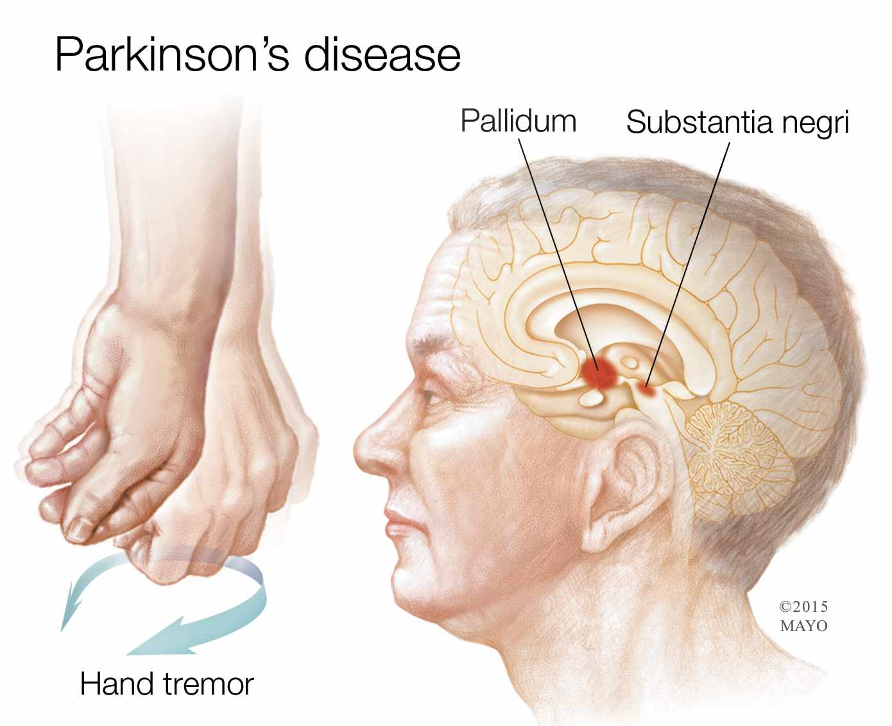
Parkinson’s Disease
PD is a slowly progressive disease, which causes a gradual loss of nerve cells in the brain that produce the neurotransmitter dopamine. Because dopamine carries signals to the part of the brain that controls movement and coordination, decreased dopamine levels lead to the cardinal motor symptoms of Parkinson’s disease:
Resting tremor
Generalized slowness (bradykinesia)
Stiffness of the limbs (cogwheel rigidity)
International Science Nutrition Society – CURARE CAUSAM - ISNS 2023

Slide 9
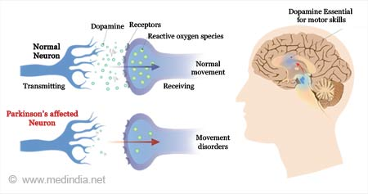
What Causes Parkinson’s disease?
The most prominent signs and symptoms of Parkinson’s disease occur when nerve cells in the basal ganglia, an area of the brain that controls movement, become impaired and/or die. Normally, these nerve cells, or neurons, produce an important brain chemical known as dopamine. When neurons die or become impaired, they produce less dopamine, which causes movement problems associated with the disease. Scientists still do not know what causes the neurons to die.
People with Parkinson’s disease also lose the nerve endings that produce norepinephrine, the main chemical messenger of the sympathetic nervous system, which controls many functions such as heart rate and blood pressure.
International Science Nutrition Society – CURARE CAUSAM - ISNS 2023

Slide 10
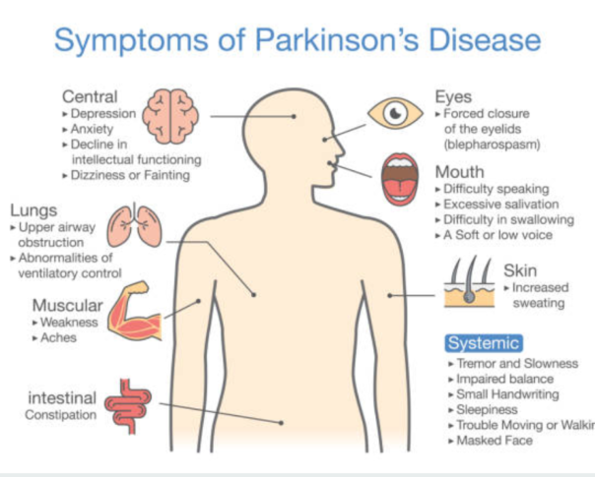
What are the symptoms of Parkinson’s Disease?
Parkinson’s has four main symptoms:
A tremor in hands, arms, legs, jaw, or head
Muscle stiffness, where muscle remains contracted for a long time
Slowness of movement
Impaired balance and coordination, sometimes leading to falls.
Other symptoms may include:
Depression and other emotional changes
Difficulty swallowing, chewing, and speaking
Urinary problems or constipation
Skin problems
International Science Nutrition Society – CURARE CAUSAM - ISNS 2023

Slide 11
Risk Factors for Parkinson’s Disease
Scientists are working to better understand the broad range of environmental exposures linked to PD
Some risk factors that may increase the risk for no—Hodgkin’s lymphoma includes:
Head Injury – traumatic brain injury- an injury that results in an alteration in the level of consciousness – has been associated with an increased risk of developing PD years after injury.
Area of Residence – there are differences in the geographic distribution of PD. These could be due to differences in environmental factors and genetic risk factors.
Occupation – certain occupational categories or job titles have been associated with a high incidence of PD, but results have been inconsistent.
Exposure to Metals - occupational exposures to various metals have been suggested to be related to the development of PD.
Solvents and Polychlorinated Biphenyls (PCBs)- Trichloroethylene (TCE) is a solvent used in many industries and is the most common organic contaminant in groundwater. Exposure to TCE was found to be associated with PD among workers whose factory jobs resulted in long-term exposure.
International Science Nutrition Society – CURARE CAUSAM - ISNS 2023

Slide 12
CASE STUDY
Patient:Male
Age: 62
History: Family history is negative.
Parkinson’s syndrome was diagnosed 1/2 year ago.
Medical history:The diagnosis of Parkinson's disease is primarily clinical, based on the patient's symptoms and a thorough neurological examination.
Symptoms:resting tremor in his right hand, stiffness, difficulty initiating movement, slowness of movement, impaired coordination.
His wife also reports that he has been experiencing a reduced sense of smell, and she has noticed a decrease in his facial expressions. His communication also slowed down.
International Science Nutrition Society – CURARE CAUSAM - ISNS 2023

Slide 13
Conventional Treatment
Although there is no cure for Parkinson’s disease, medicines, surgical treatment, and other therapies can often relieve some symptoms.
Medications can help treat the symptoms of Parkinson’s by:
Increasing level of dopamine in the brain.
Having an effect on the other brain chemicals, such as neurotransmitters, which transfer information between brain cells
Helping control non-movement symptoms
The main therapy for Parkinson’s is levodopa. Nerve cells use levodopa to make dopamine to replenish the brain’s dwindling supply.
The doctor may prescribe other medicine to treat Parkinson’s symptoms, including:
- Dopamine agonist to stimulate the production of dopamine in the brain
- Enzyme inhibitors (MAO-B inhibitors, COMT inhibitors) to increase the amount of dopamine by slowing down the enzymes that break down the dopamine in the brain
- Amantadine to help reduce involuntary movements
In his case:
Levodopa/Carbidopa/Entacapone 100 mg/25 mg/200 mg,
International Science Nutrition Society – CURARE CAUSAM - ISNS 2023

Slide 14
Method
PROPRIETARY BLENDS LEGEND
Proprietary Blend I: Silica, Vitamin C, and Trace Minerals
Proprietary Blend II: N-acetyl L-tyrosine, Anhydrous Caffeine, L-theanine, Velvet Bean Seed, Pine Bark, Curcumin, and Vitamin D
Proprietary Blend III: Black seed oil, Resveratrol, turmeric, Raspberry Ketones, Apple Cider Vinegar, Aloe Vera, and D-Ribose
Proprietary Blend IV: Vitamin C, zinc sulfate, and vitamin D3
Proprietary Blend V: Inulin, Green Banana flour, apple fiber, bacillus coagulans, spirulina, wheat grass, barley grass, alfalfa leaf, flax seed, psyllium husk powder, chlorella, broccoli, kale, spinach, green cabbage, parsley, aloe vera, cayenne pepper, blueberry powder, pomegranate seed powder, and MCT coconut oil powder
Proprietary Blend VI: Vitamin K2, Vitamin D3, Vitamin C, Magnesium oxide, OmniMin AC (trace mineral blend) Quercetin, and NAD
Proprietary Blend VII: Bovine collagen and hydrolyzed bovine colostrum
Proprietary blend I: 2x6 drops, morning and
evening, for 3 days, then every 3 days then
increased by 1-1 drops every 3 days to 2x12
Proprietary blend II :1 in the morning for 7 days, then 1 in the morning and 1 in the afternoon for 7 days, then 2 in the morning and 1 in the afternoon
Proprietary blend III: Proprietary blend III: 1/2 sachet in the morning for 7 days then 1 sachet in the morning for 7 days then 1 sachet in the morning and 1 sachet in the evening
Proprietary blend IV: 1/2 teaspoon in the
morning for 7 days, then 1 teaspoon in the morning
Proprietary blend V: 1 teaspoon in the
in the evening
Proprietary blend VI: 1 in the
morning for 7 days then 1 in the morning and 1 in the evening
International Science Nutrition Society – CURARE CAUSAM - ISNS 2023

Slide 15
Additional Treatment
Physical therapy and exercise programs can help improve mobility, balance, and strength.
Speech therapy and occupational therapy may also be beneficial in managing speech and fine
motor difficulties.
A special diet based on my personal experience.
International Science Nutrition Society – CURARE CAUSAM - ISNS 2023

Slide 16
Results
After 1 month :
Reduced stiffness, tremors in the hand.
His sense of smell improved and he became a little more lively.
After 3 month:
The difficulty starting movement decreased, coordination improved.
The stiffness and tremor in the hand improved further.
His facial expressions became more animated again
His communication has been restored. His mood improved.
And not only the family, but also the patient could report on the improvement.
Based on these, the patient's quality of life improved!!
International Science Nutrition Society – CURARE CAUSAM - ISNS 2023

Slide 17
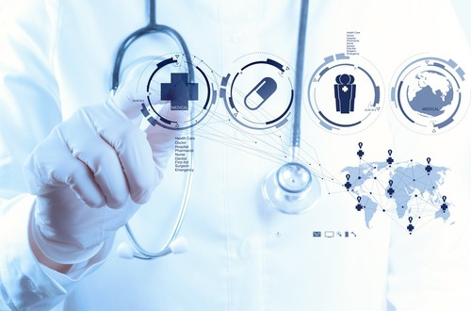
Research Studies
International Science Nutrition Society – CURARE CAUSAM - ISNS 2023

Slide 18
Mucuna Pruriens in Parkinson’s Disease By Roberto Cilia, MD,corresponding author Janeth Laguna, MD, Erica Cassani, MD, Emanuele Cereda, MD, PhD, Nicolò G. Pozzi, MD, Ioannis U. Isaias, MD, PhD, Manuela Contin, PharmD, Michela Barichella, MD, and Gianni Pezzoli, MD
Objective: In this study, it was investigated whether Mucuna pruriens may be used as an alternative source of L-DOPA for individuals with Parkinson’s Disease who can not afford long-term therapy.
Method: Eighteen patients with advanced PD received the following treatments, whose sequence was randomized: (1) dispersible levodopa at 3.5 mg/kg combined with the dopa-decarboxylase inhibitor benserazide (LD+DDCI; the reference treatment); (2) high-dose Mucuna pruriens (MP-Hd; 17.5 mg/kg); (3) low-dose Mucuna pruriens (MP-Ld; 12.5 mg/kg); (4) pharmaceutical preparation of LD without DDCI (LD−DDCI; 17.5 mg/kg); (5) Mucuna pruriens plus benserazide (MP+DDCI; 3.5 mg/kg); (6) placebo.
Results: When compared to LD+DDCI, Mucuna pruriens-levodopa showed similar motor response with fewer dyskinesias and AEs, while Mucuna pruriens-high dose induced greater motor improvement at 90 and 180 minutes, longer ON duration, and fewer dyskinesias.
https://www.ncbi.nlm.nih.gov/labs/pmc/articles/PMC5539737/
International Science Nutrition Society – CURARE CAUSAM - ISNS 2023

Slide 19
Neuroprotective Activities of Curcumin in Parkinson’s Disease: A Review of the Literature Eslam El Nebrisi
In this context, this review focuses on the neuroprotective activities of curcumin in PD and the various mechanisms involved. Curcumin’s pharmacokinetics, pharmacodynamics, biological, cellular, and molecular properties are all addressed. A special emphasis is given to curcumin’s neuroprotective activities via a α7-nAChR-mediated mechanism, safety profile, and current and upcoming clinical trials for clinical application.
Overall, the current findings of the clinical trial on nicotinic receptors and PD or curcumin and neurodegenerative disorders such as PD are very promising, but more pre-clinical studies and clinical trials are needed to improve curcumin’s bioavailability and define its hidden targets.
The interaction of curcumin with α7-nACh receptors provides further evidence for a potential neuroprotective role for curcumin in PD. Additionally, curcumin and derivatives show a high safety profile with minimal reported toxicity as demonstrated both in in vitro and in in vivo studies in PD models. The evidence reviewed supports curcumin’s powerful molecular and cellular effects in neurodegenerative disorders as an appealing strategy for improving PD management and prognosis.
https://www.ncbi.nlm.nih.gov/pmc/articles/PMC8537234/
International Science Nutrition Society – CURARE CAUSAM - ISNS 2023

Slide 20
Vitamin D and Parkinson’s Disease Antonia Pignolo, Sergio Mastrilli, Chiara Davi, Valentina Arnao, Paolo Aridon, Felipe Augusto dos Santos Mendes, Cesare Gagliardo, and Marco D’Amelio
Vitamin D is important for brain development, mature brain activity and associated with many neurological diseases, including Parkinson’s disease (PD).
High frequency of vitamin D deficiency in patients with Parkinson’s disease compared to control population was noted nearly twenty years ago.
Vitamin D deficiency seems to be related to disease severity and disease progression, evaluated by Unified Parkinson’s Disease Rating Scale (UPDRS) and Hoehn and Yahr (H&Y) scale, but not with age of PD onset and duration of disease.
In summary, as low serum 25(OH)D levels might be correlated with an increased risk of developing PD, higher 25(OH)D levels seems to be associated with better motor symptoms, especially with improved balance control.
https://www.ncbi.nlm.nih.gov/pmc/articles/PMC8953648/
International Science Nutrition Society – CURARE CAUSAM - ISNS 2023

Slide 21
References
https://www.nia.nih.gov/health/parkinsons-disease
https://www.ncbi.nlm.nih.gov/pmc/articles/PMC5539737/
https://www.ncbi.nlm.nih.gov/pmc/articles/PMC8537234/
https://www.ncbi.nlm.nih.gov/pmc/articles/PMC8953648/
International Science Nutrition Society – CURARE CAUSAM - ISNS 2023

Slide 22
Thank You for Joining Us This Week!!
International Science Nutrition Society – CURARE CAUSAM - ISNS 2023

